Slide 1

Billing System Software
Course Title: Programming with JAVA
Course Code: CSE 412
Presented By:
Md. Mizanur Rahman
ID: 201014061
Sec: 01
Presented To:
Md. Ashikur Rahman
Assistant Professor (CSE),
ULAB

Slide 2



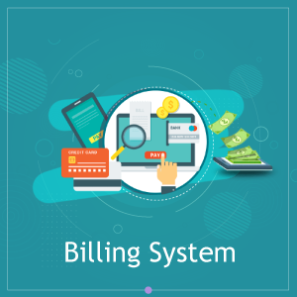
Billing System Software
Overview
Understanding the requirements
Objectives
Design and Development
Result / Analysis
Conclusion

Slide 3
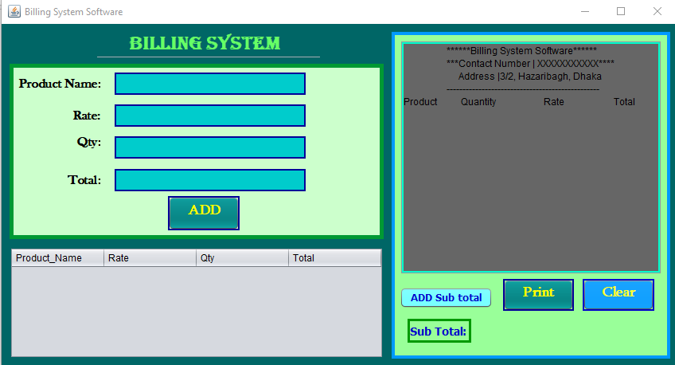
Overview
Key Points
Billing System Software
Calculate Bill
Input and Display Bill

Slide 4
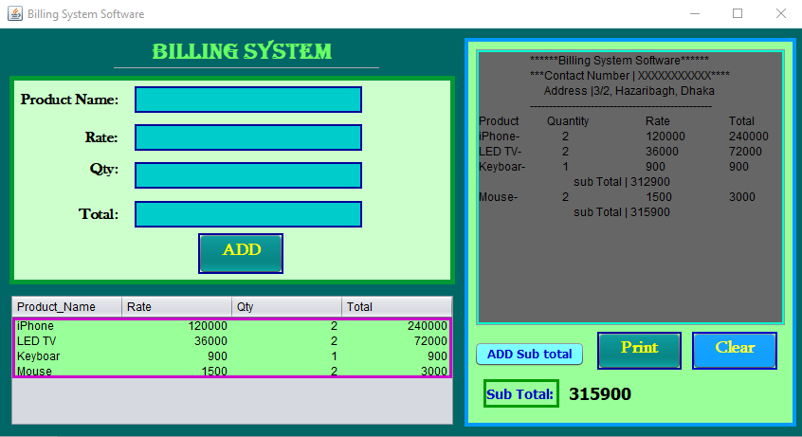
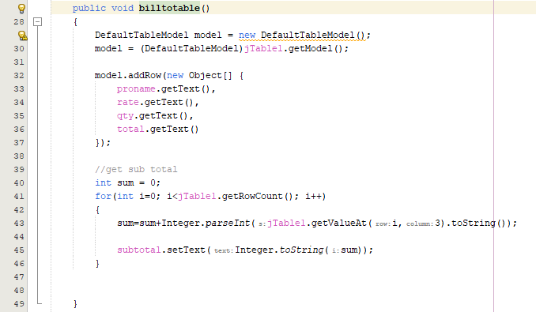
Understanding the requirements
Key Points
Used modern tools
Broad Uses of Billing System
Used For Calculate Bill
Need Basic Feature of JAVA

Slide 5
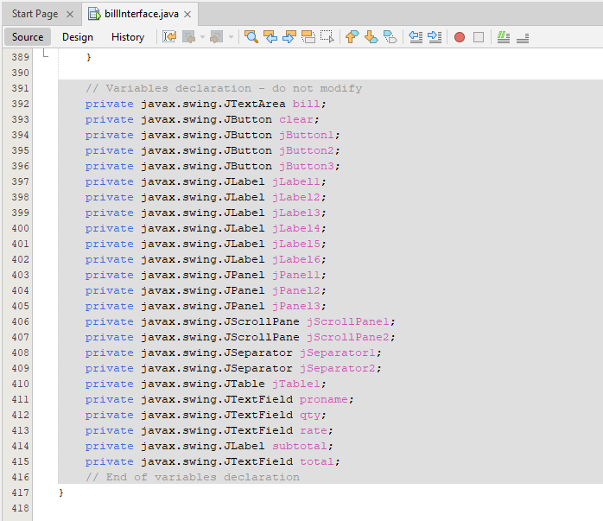
Design and Development
Key Points
Drew a sketch
Designed Properly
Used GUI
Built Proper Connection

Slide 6
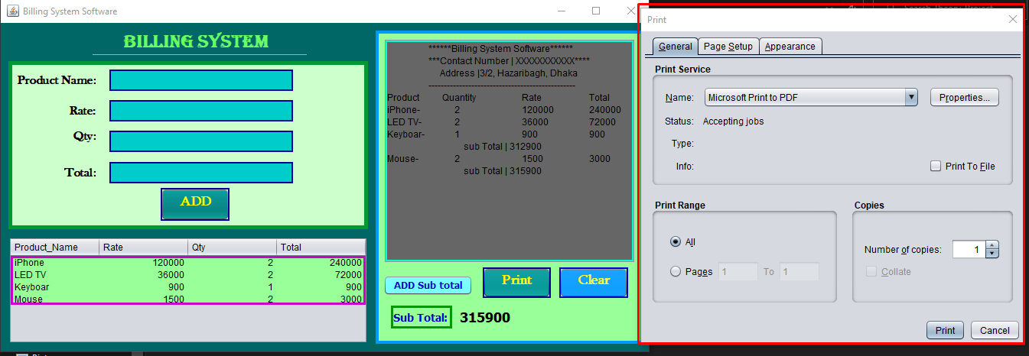
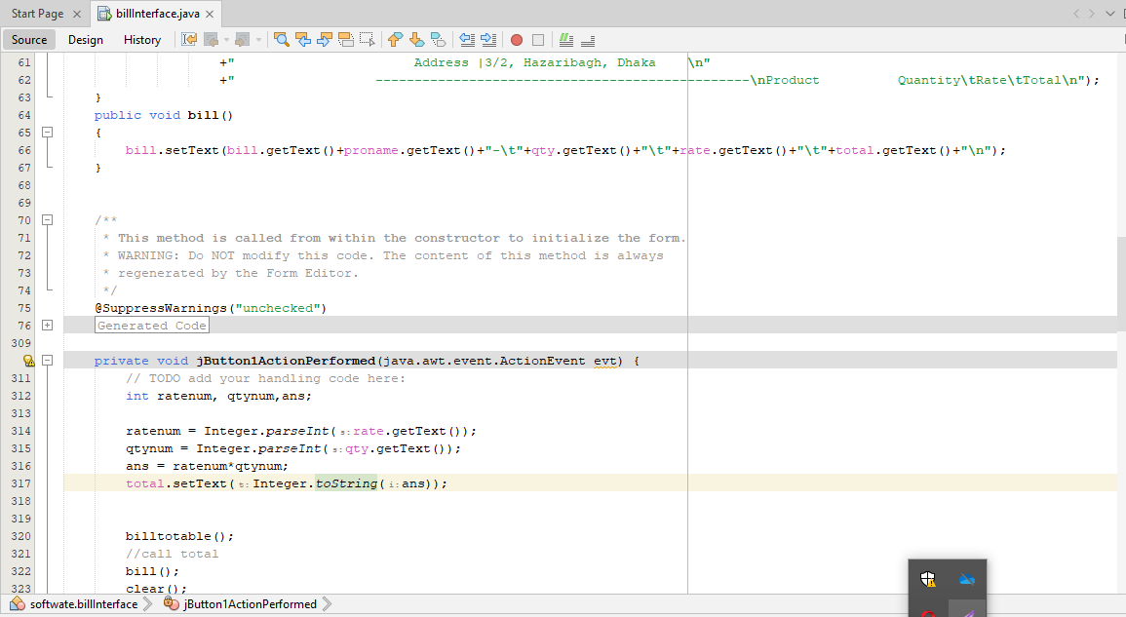
Result / Analysis
Key Points
Can Add Products
Will Get Total And Sub Total
Will Store in a Table
Able To Print Bill

Slide 7
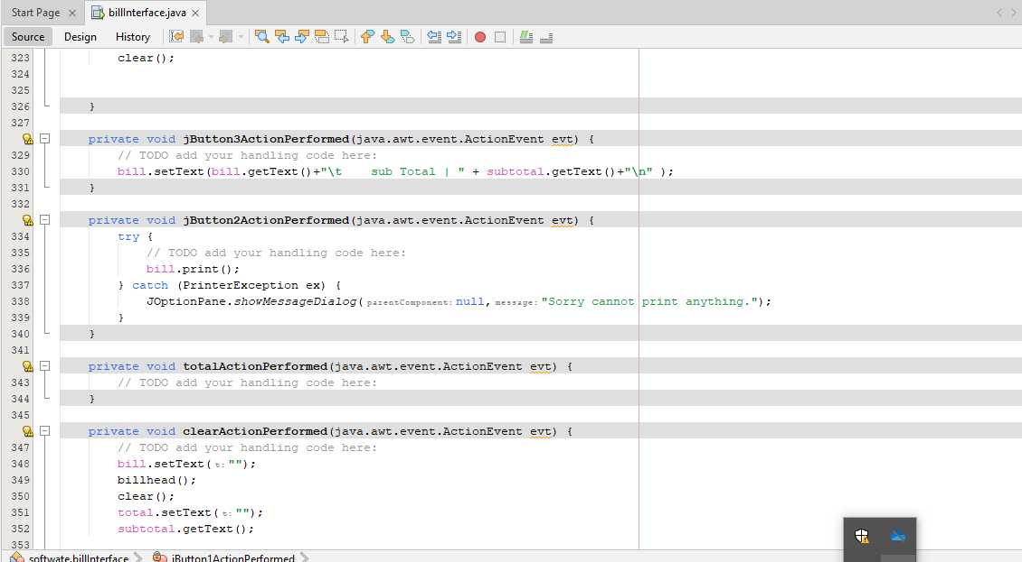
Conclusion
Key Points
Used Graphis of JAVA
User Friendly Software
Checked Multiple Times
No Error Is Found

Slide 8
Thank you

